Slide 1

ECE201R01 : Microprocessor & Microcontroller
Unit I: 8086 Interrupts
8086 - Architecture

Slide 2
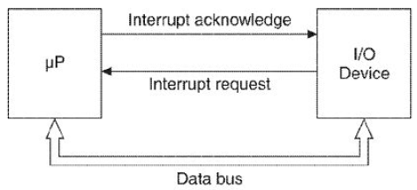
8086 – Interrupt handling
8086 - Interrupts

Slide 3
8086 Interrupts
Hardware: NMI & INTR
Software: INT n; where 0 ≤ n ≤ 255
The maskable interrupt at INTR pin of the 8086 is high-level triggered.
Dedicated software interrupts:
  INT 0, INT 1, INT 2, INT 3 & INT 4
Interrupt vector address calculation:
Interrupt vector address = 4 × n
Example: INT 02
Starting Vector address: 4 x 02 = 08
Vector Address | ISR Address
0x08 | IP_{L}
0x09 | IP_{H}
0x0A | CS_{L}
0x0B | CS_{H}
8086 - Interrupts

Slide 4
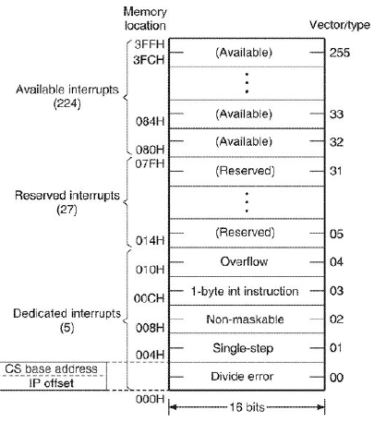
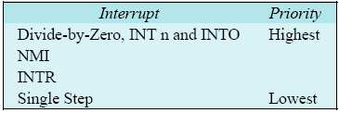
8086 Interrupts
8086 - Interrupts

Slide 5
Divide-by-zero interrupt
Divide-by-zero: if the quotient from either DIV or IDIV instruction is too large to fit in the quotient register, the 8086 will generate the Divide-by-Zero interrupt request.
  Since the 8086 response is automatic, this interrupt cannot be disabled.
Single step interrupt
When TF (Trap Flag) is set, the 8086 executes the Single Step Mode Interrupt after the execution of each instruction.
Non Maskable Interrupt (NMI)
A positive edge (low-to-high) on NMI pin triggers the NMI interrupt.
NMI interrupt has a lower priority than the software interrupts but has a higher priority over the maskable interrupt at the INTR pin.
8086 - Interrupts

Slide 6
Breakpoint interrupt
Used for inserting breakpoints for debugging the program.
  8086 executes the program up to the breakpoint and then branches to breakpoint ISR.
  We may write the breakpoint ISR to display or store the contents of the various registers/memory locations for debugging the program.
Overflow interrupt
Execution of INTO occurs if the Overflow flag is set
  Overflow is set when the signed result of an arithmetic operation on two signed numbers is too large to be represented in the destination register or memory location.
8086 - Interrupts

Slide 7
Maskable Interrupt
A high-level at INTR pin will cause the acceptance of interrupt request by the 8086
Interrupt at INTR pin can be enabled (IF = 1) or can be disabled (IF = 0)
When the interrupt request at INTR pin is accepted, the 8086 performs the following functions:
Two interrupt acknowledgement bus cycles are executed
First cycle: 8086 floats the data bus lines(AD0–AD15) and sends out an INTA pulse, to indicate that interrupt acknowledgement cycle is in progress
Second cycle: external device must send back a byte (interrupt type number 0 – FF) on AD0–AD7 (This data is multiplied by 4 to get the vector information on the interrupt)
PUSH Flag, CS and IP registers onto the stack, clear IF and TF in Flag register
New CS and IP register contents re taken from the vector location
calculated earlier in second INTA cycle
8086 - Interrupts

Slide 8
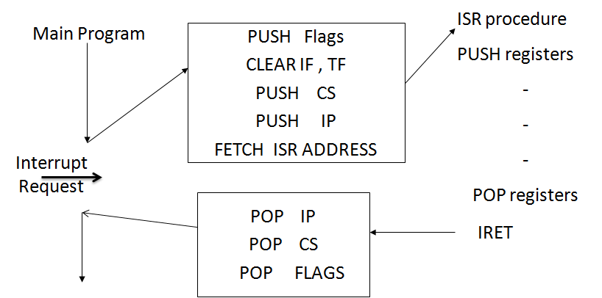
8086 – Interrupt handling
8086 - Interrupts

Slide 9
Thank you . . .
8086 - Interrupts

